Slide 1

Project 1
Monash bootcamp – Data analysis

Slide 2

HOUSE AND RENTAL price REPORT
A Data ANALYSIS OF THE METRO MELBOURNE SUBURBS FOR INVESTMENT
Monday 27 June 2022

Slide 3

Content
The overall goal of this project is to determine if there has been a steady increase in the prices of houses and rent costs in Metro Melbourne during 2010-2020.
The following data analysis will respond the questions below based on the hypothesis:
Q1. How have prices increased over the last decade in Metro Melbourne?
Q2. Which are “The top ten suburbs” in Victoria for housing prices increment and rental cost increase over the last decade?
Q3. Which are “The bottom ten suburbs” in Victoria for housing prices fall and rental cost reduction over the last decade?
Q4. The suburbs with the highest and lowest number of leased properties.
Q5. The correlation between housing price/ rental cost and suburb distribution
Q6. Comparation of the average housing price & average rental cost in Eastern, Western, Northern and Southern suburb over the time period (or year 2020 only) by using appropriate charts.
Q7. Producing heat map and markers with info box regarding median housing price and rental cost from 2010 - 2020 for all areas in Victoria.

Slide 4


METHOD
The data compiled provides property statistics for Greater Melbourne suburbs and yearly medians over a ten-year period.
The data analysis has been doing using:
pandas for cleaning and creation of data frames,
Python / matplotlib for the development of charts and heatmaps,
Statistics and google maps for heatmap showing the suburbs
Databases
The databases we used for this analysis have been obtained from the following sources:
Victorian Property Sales Report
Median House by Suburb, Time Series
VIC.GOV.AU
Rental Report - Quarterly:
Moving Annual Rents by Suburb
VIC.GOV.AU https://discover.data.vic.gov.au/dataset/rental-report-quarterly-moving-annual-rents-by-suburb
Data analysis

Slide 5



Q1 house prices increment by suburbs 2010-2020
Q1 – House Prices
Q1 – Rent Prices
High prices in Melbourne suburbs have been increasing steadily in the last decade, showing that the top ten most costly suburbs (Brighton East, Port Melbourne, etc.) have maintained its rank during the period.
Medium and lower prices are in suburbs outside the city area, as far located from the CBD the lowest the price.
Other suburbs considered median price at the beginning of the decade, have gained a better position as more desired by the consumers (e.g., Box Hill, North Melbourne or Chadstone)
Not surprisingly, renting market follows the same pattern as the housing market. High prices in renting are in selected suburbs, located closest to the city. There are exceptions such as Clayton, Caufield Malvern East, or Parkville, where university campus are located, and demand of accommodation for international students is high.
Heatmaps 1 – 2 next slide

Slide 6
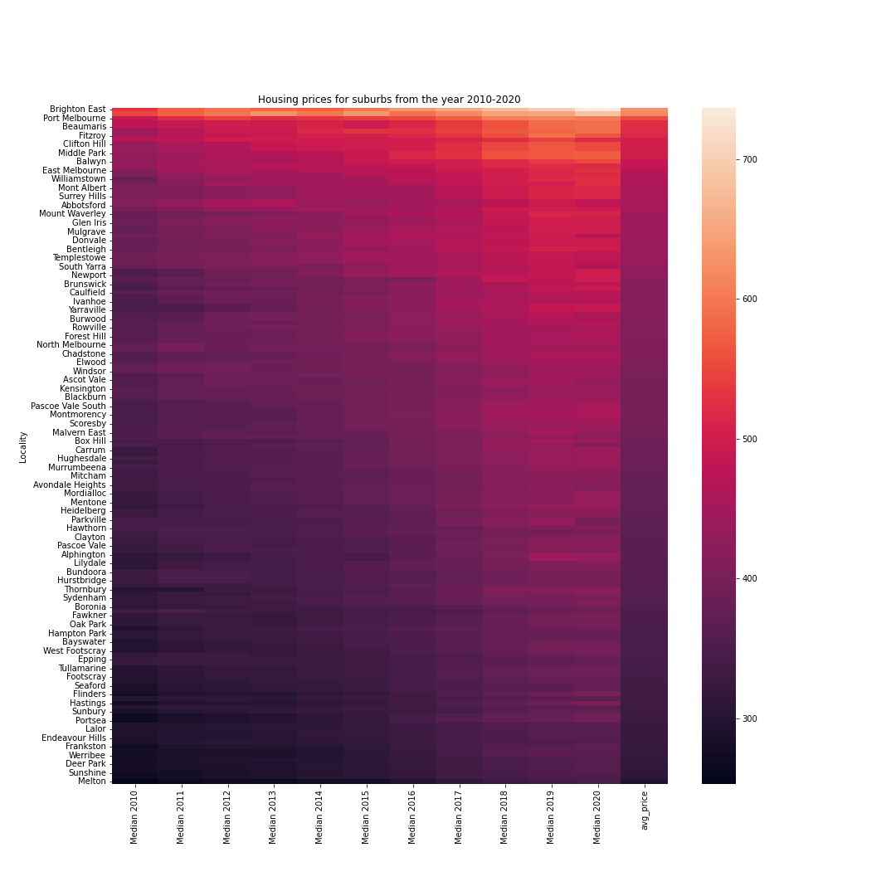
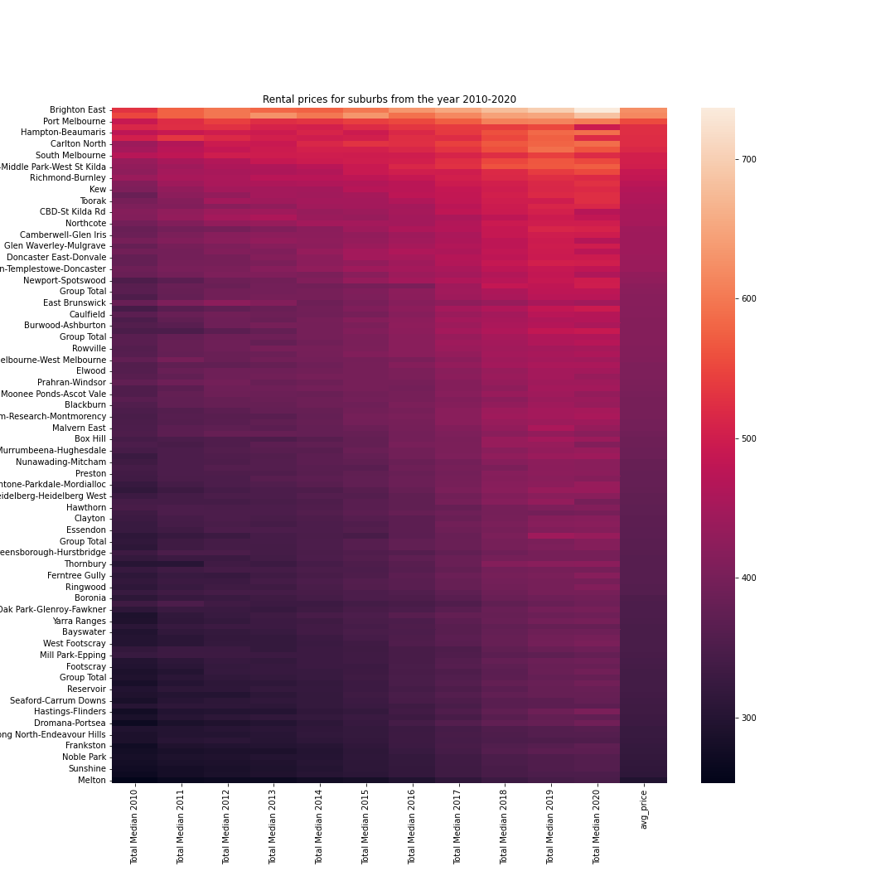
Notes:
Residential median prices varied across Melbourne suburbs. The median sales represents a weekly cost of $ 500 for a house median price of $ 750,000.
The fluctuation of the prices shows similar patterns between house and rental prices, suburbs close to the city have the highest prices for renting and property investment
However, the prices decreased around 4% between 2019 and 2020., for both house prices and rental costs.
The median price is the value of the middle item when all sale prices are arranged in ascending order of magnitude.

Slide 7
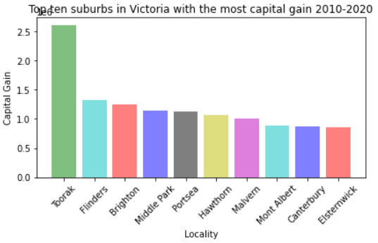
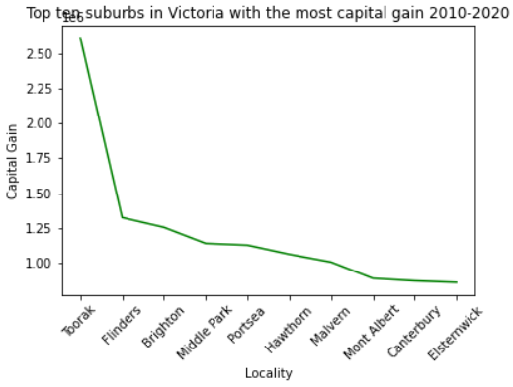
Q2. Which are the top ten suburbs in Victoria? house price

Slide 8
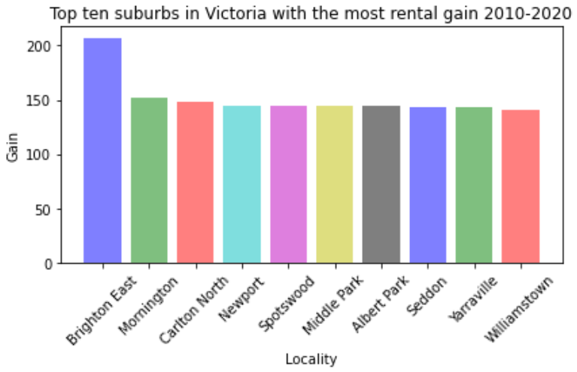
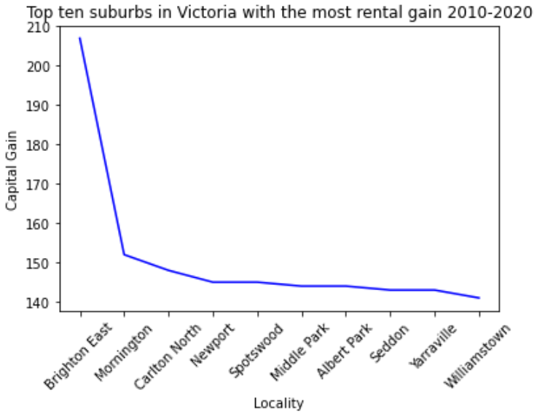
Q2. Which are the top ten suburbs in Victoria? RENTAL price

Slide 9
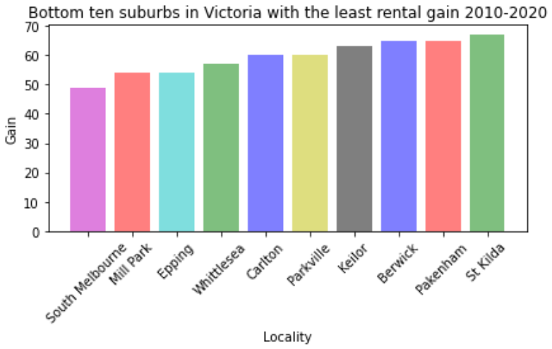
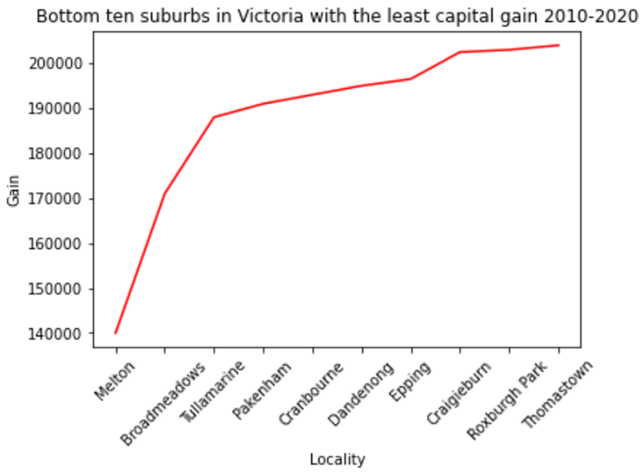
Q3. Which are the BOTTOM ten suburbs in Victoria? HOUSE PRICE

Slide 10
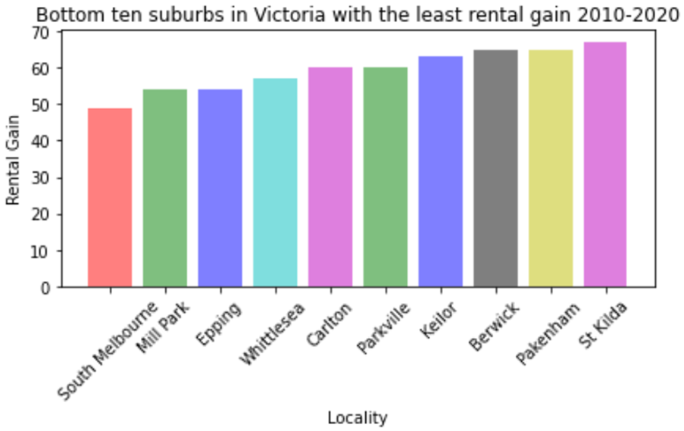
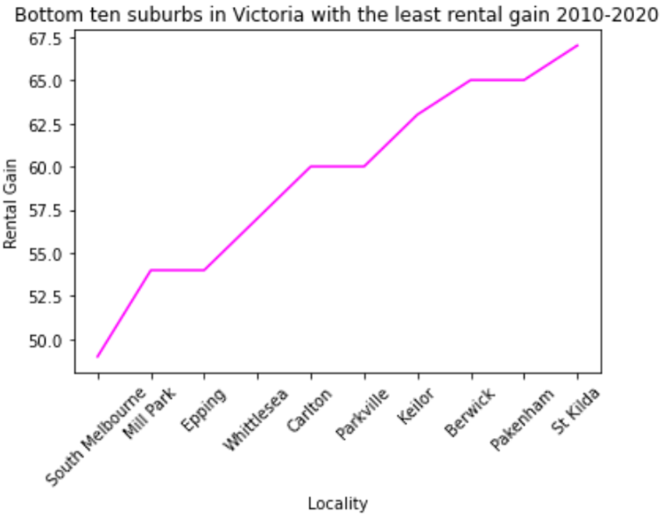
Q3. Which are the BOTTOM ten suburbs in Victoria? RENTAL Prices

Slide 11

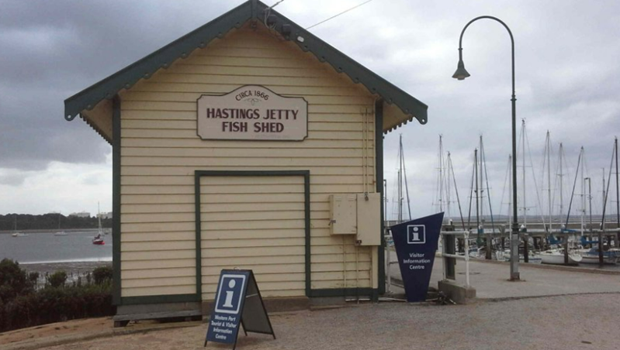
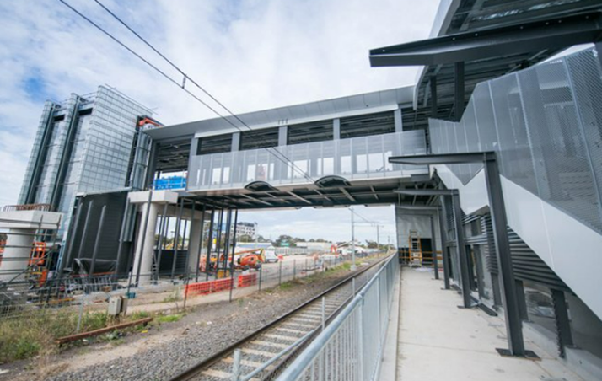
Q4 which are the suburbs with the highest and lower number of leased properties
2010 | 2020 | (+)
794 | 964 | - 170
Hoppers crossing
hastings
2010 | 2020 | (+)
7,767 | 4,387 | 3,380

Slide 12
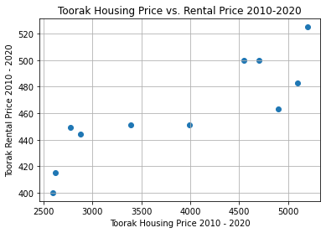
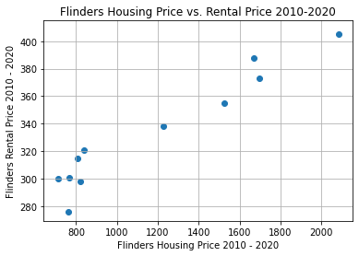
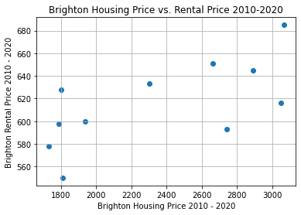
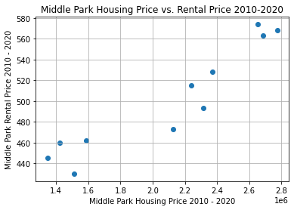
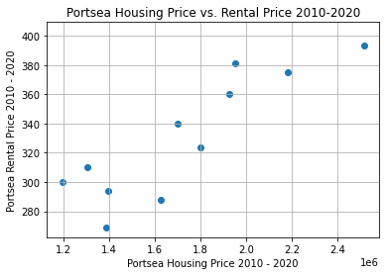
Q5.CORRELATION BETWEEN House PRICE & RENTAL PRICE
The equation of the best-fit linear regression line for this chart is
y=0.03x+342.56
The r-squared correlation coefficient for this line is 0.86
The equation of the best-fit linear regression line for this chart is
y=0.08x+237.46
The r-squared correlation coefficient for this line is 0.96
The equation of the best-fit linear regression line for this chart is y=0.05x+510.34
The r-squared correlation coefficient for this line is 0.66
The r-squared correlation coefficient for this line is 0.94
The r-squared correlation coefficient for this line is 0.87
Notes:
The scatter plots in this slide and next shows the correlation between to total house price and the total rental price for the top ten suburbs, demonstrating here how much the housing price affects the rental cost in each of the suburbs.
As the x variable goes up (housing price) we can see that there is a positive correlation with the rent price, so that the price.

Slide 13
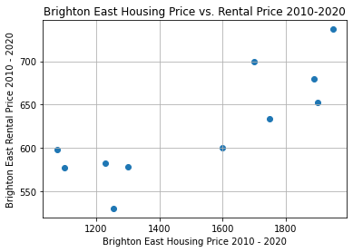
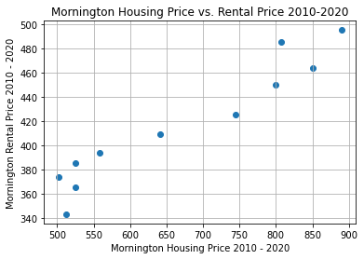
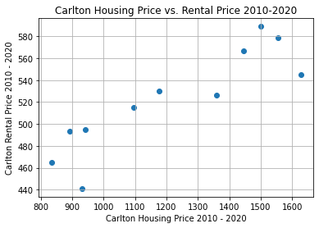
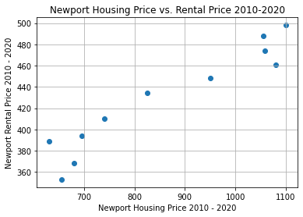
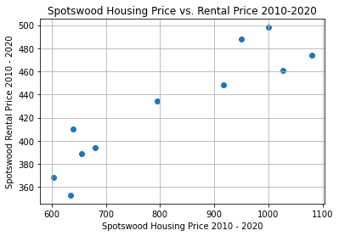
Q5 The CORRELATION BETWEEN HOUSING PRICE & RENTAL Price.
The equation of the best-fit linear regression line for this chart is y=0.15x+392.90
The r-squared correlation coefficient for this line is 0.82
The equation of the best-fit linear regression line for this chart is y=0.32x+203.59
The r-squared correlation coefficient for this line is 0.96
The equation of the best-fit linear regression line for this chart is y=0.14x+352.29
The r-squared correlation coefficient for this line is 0.88
The r-squared correlation coefficient for this line is 0.95
The r-squared correlation coefficient for this line is 0.92

Slide 14
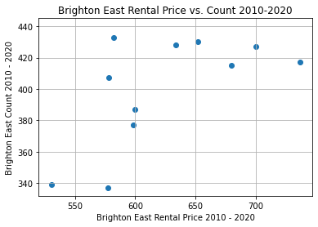
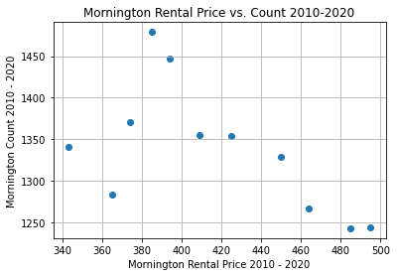
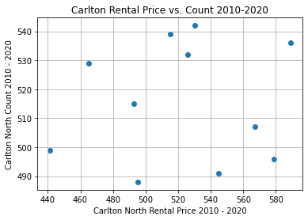
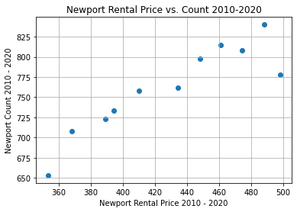
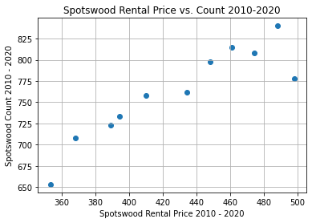
Q5 The CORRELATION BETWEEN RENTAL Price & count.
The equation of the best-fit linear regression line for this chart is y=0.36x+176.82
The r-squared correlation coefficient for this line is 0.63
The equation of the best-fit linear regression line for this chart is y=-0.91x+1715.39
The r-squared correlation coefficient for this line is -0.60
The equation of the best-fit linear regression line for this chart is y=0.03x+497.79
The r-squared correlation coefficient for this line is 0.08
The r-squared correlation coefficient for this line is 0.91
The r-squared correlation coefficient for this line is 0.91
Notes:
As shown in these graphs, there are some suburbs, such as Brighton East, Carlton North, and Mornington Peninsula that do not follow a straight line, but in general all top ten suburbs shows a positive correlation between rent cost and house price increment.
These suburbs are the most valuable to invest, but at the same time they are in the highest demand.

Slide 15
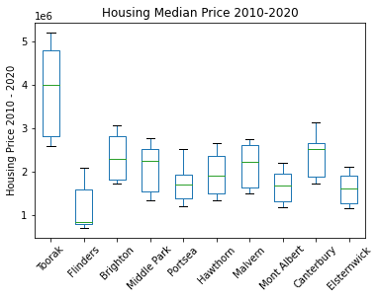
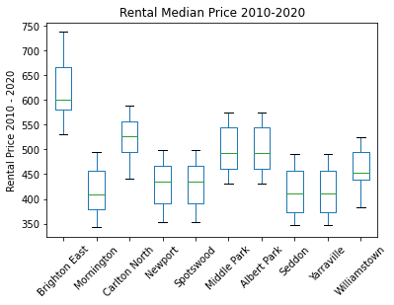
Q5 housing and rental price top 10 suburbs
2010-2020
Notes:
Box Plots displays 5 points representing the centring, spread, and distribution of the house / rent pricing
The box lengths are comparatively similar in most of the suburbs: this suggest that overall prices are similar for rent and housing in the suburbs.
Rent Median price box plots are more consistent compared with house pricing, where the box are mostly uneven
Again, Toorak and Brighton East go well above the median showing that these are the most expensive suburbs from the top 10 analised
Most of the suburbs medians are at the same level in the box, but they have different distributions
There are not outliers, as all the data points are concentrated close to the median
Flinders shows a skewed distribution (right-skewed, the peak of the graph lies on the left side of the graph, or positive skewed) which means that the data points are higher in value

Slide 16
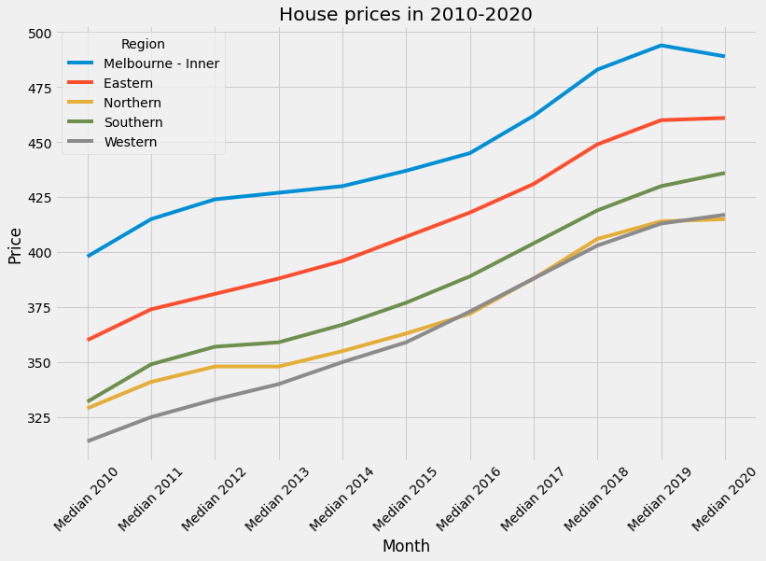
Q6 Median House Price by Region
Q3 – House Prices
Q3 – Rent Prices
Text text text text text text Text text text text text text
Text text text text text text
Text text text text text text
Text text text text text text
Text text text text text text Text text text text text text
Text text text text text text
Text text text text text text
Text text text text text text
Text text text text text text
Text text text text text text

Slide 17
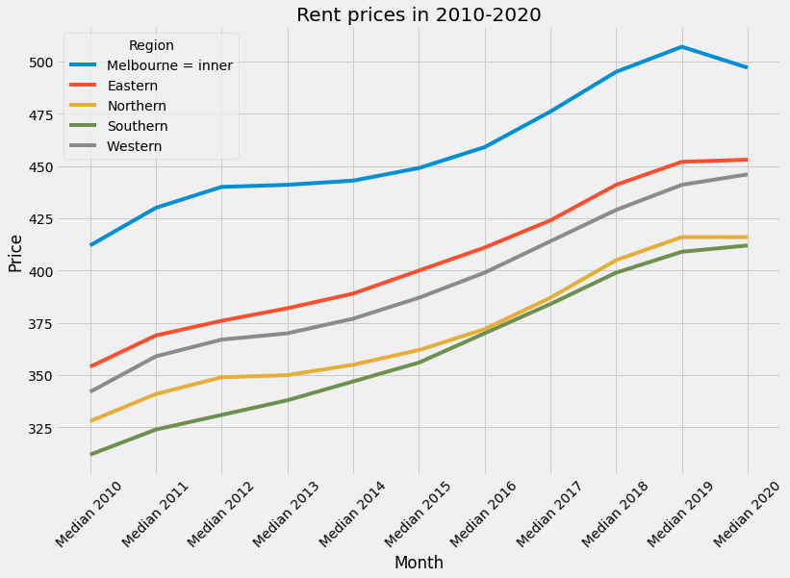
Q6 Median Rent Price by Region
Q3 – Rent Prices
Text text text text text text Text text text text text text
Text text text text text text
Text text text text text text
Text text text text text text
Text text text text text text Text text text text text text
Text text text text text text
Text text text text text text
Text text text text text text
Text text text text text text
Text text text text text text

Slide 18
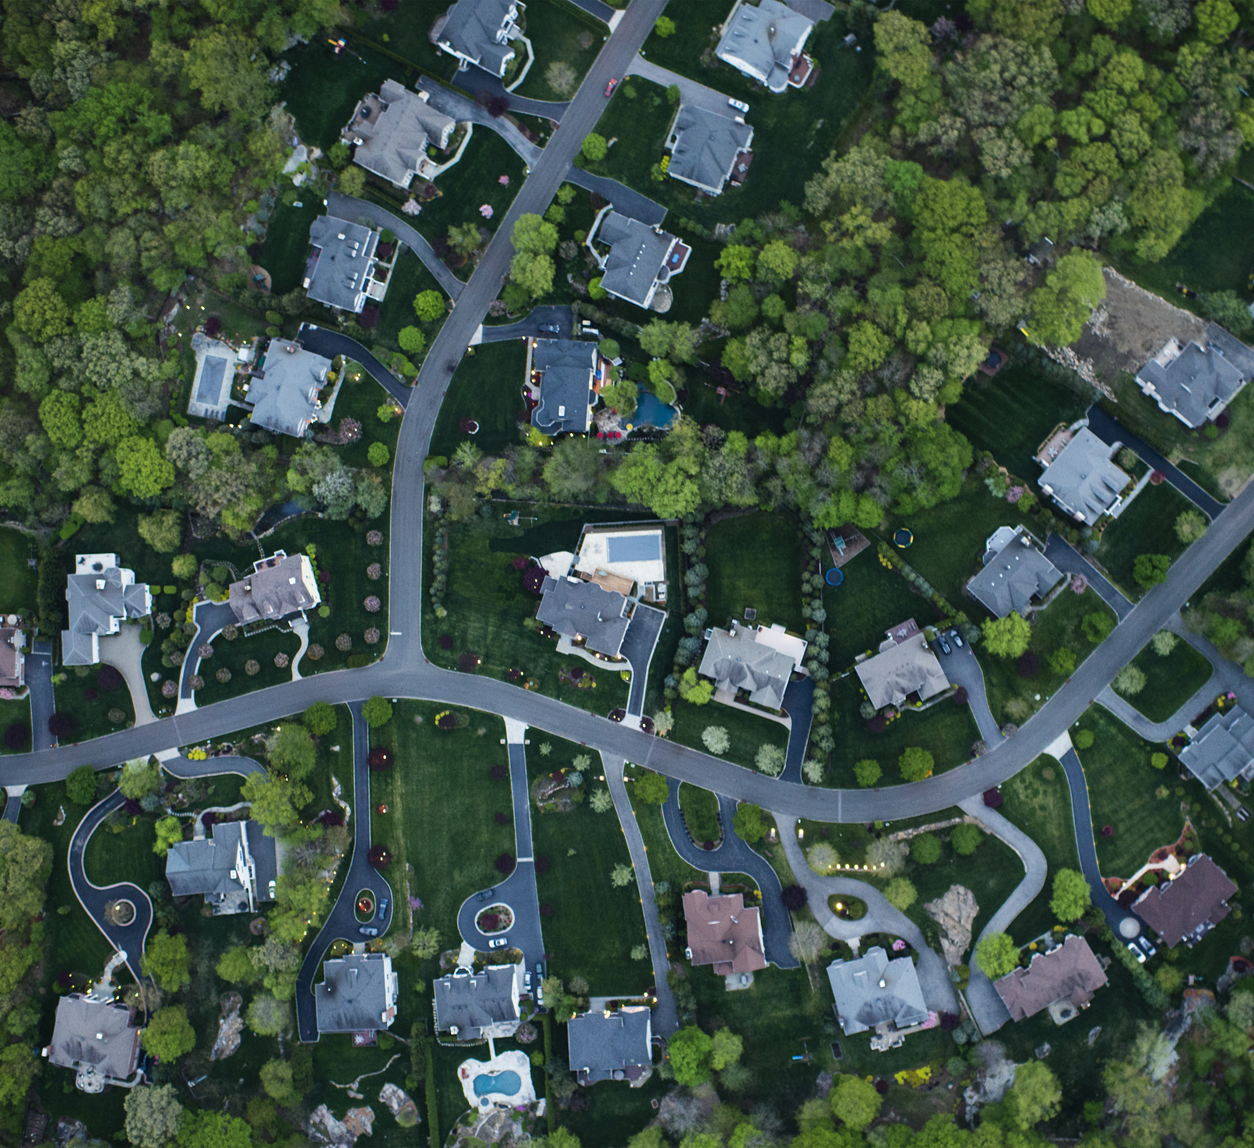
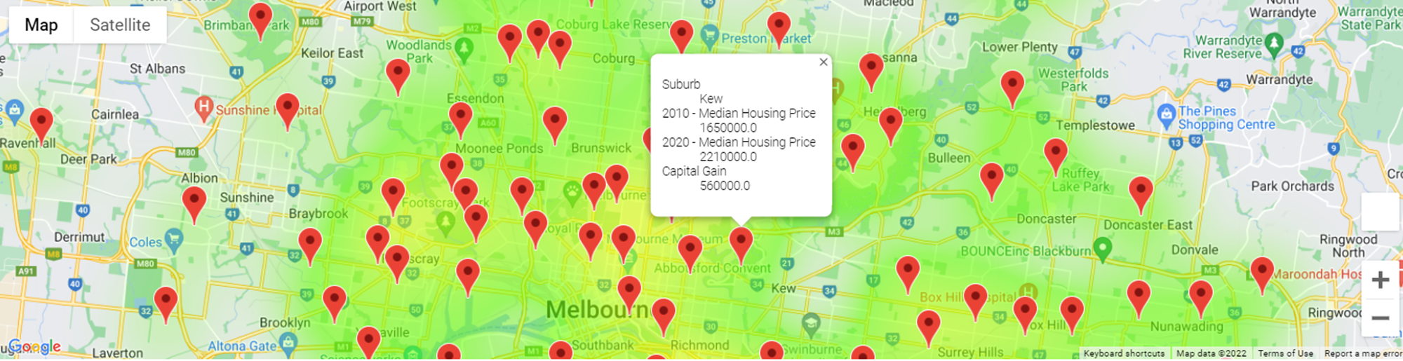
Q7. AVERAGE HOUSE PRICES 2010-2020

Slide 19
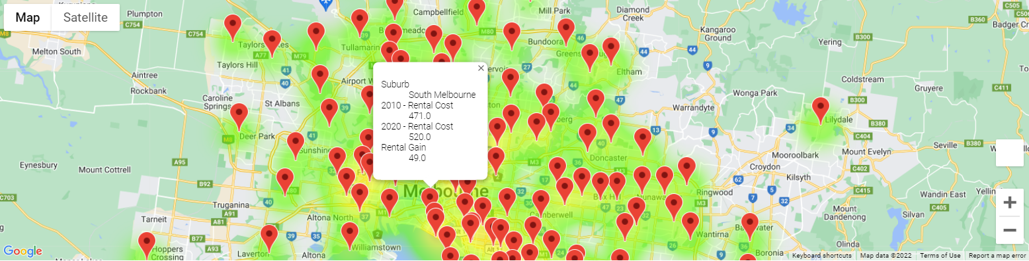
Q7. AVERAGE RENT PRICES 2010-2020

Slide 20
Conclusion
The overall goal of this project is to determine if there has been a steady increase in the prices of houses and rent costs in Metro Melbourne during 2010-2020.
Through the analysis of the data, it can be showed that:
There has been a steadily increase in the house and rent prices in the last 10 years, with an overall median increment of around 50% for the period.
The top ten suburbs with highest cost effectiveness are well distributed along the main regions: Inner Melbourne (CBD and closer suburbs), Eastern (Toorak, Malvern), Western (Williamstown, Yarraville), Northern (Canterbury), and Southern (Mornington Peninsula).
Despite the reduction in house pricing during 2019-2020 (around -4%) house and rent prices have a general accumulated increment of around 50% in the last decade.

Slide 21
RECOMMENDATION
We recommend our clients to keep house investment as one of the strongest profitable alternatives in the long term. As we have demonstrated in this presentation, historically, property investment always goes up in price.
Despite the potential impending downturn, it is still feasible to be successful with investing in property in Victoria.

Slide 22



team
Chloe THan
Rachel sun
Claudia Sandoval

Slide 23

Thank you!

Slide 24
Questions?

